Slide 1
Waves of the Atlantic
John Christman
IST 652 Final Project

Slide 2
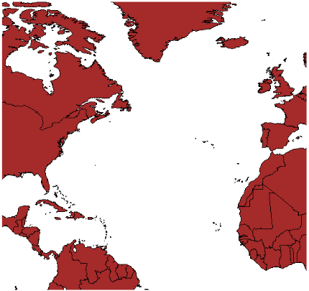
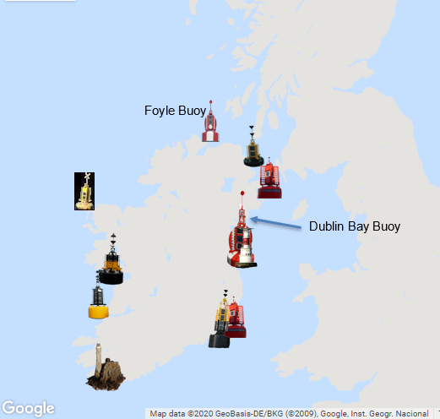
Data Sets
Set 2: Wave heights collected from 995 tweets by the Foyle and Dublin Bay Buoys. 11-22-20 to 11-29-20
Set 1: Wave heights collected between 95W and 5E longitude, 75N to the Equator (5 degree increments) from 1964-1993
Notes:
Data set one – structured. Set 2 semi-structured Tweet data

Slide 3
Questions
What was the distribution of wave height across each degree of longitude? Since the longitudes covered the width of the Atlantic Ocean, was there any relationship between the distance from land and the wave height? How did the wave height compare to observed wave heights from the coastal buoys?
What was the mean wave height by month across the 30-year period? The final question grouped mean wave heights over the 30-year observation period by month to identify if there was a relationship between mean wave height and month of the year. What might the average suggest for predicting coastal wave height variation?
What was the mean wave height by latitude? What might be inferred for wave heights in coastal communities north or south of the coastal buoys?
Is there a trend in wave heights over the observed 30-year study? What might be inferred for the future of ocean wave heights?
Notes:
Trends and the relationship to the tweet data

Slide 4
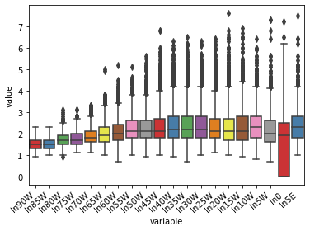
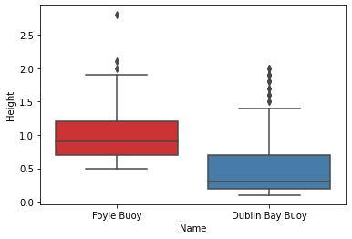
Results
Wave Height Distributions

Slide 5
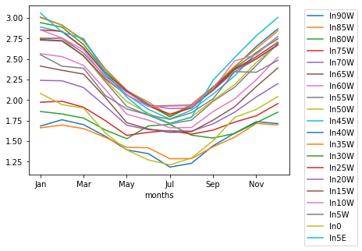
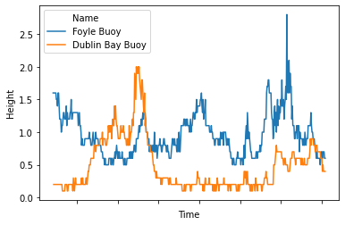
Results
Wave Height Over Time

Slide 6
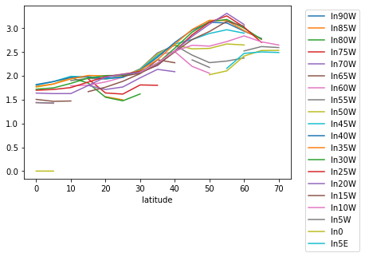
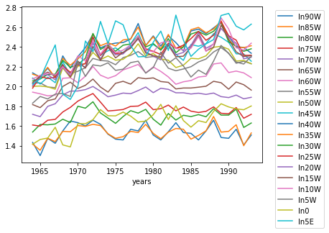
Results
Wave Height by Latitude Wave Height by per Year by Longitude

Slide 7
Sources
Gulev, S. K., V. Grigorieva, and A. Sterl. 1998. Global and North Atlantic Atlas of Monthly Ocean Waves. Research Data Archive at the National Center for Atmospheric Research, Computational and Information Systems Laboratory. https://doi.org/10.5065/DTJJ-HZ16. Accessed: 18 OCT 2020.
Twitter®, Commissioners of Irish Lights: https://irishlights.ie/. Dublin Bay and Foyle Buoys
QUESTIONS?

